Slide 1
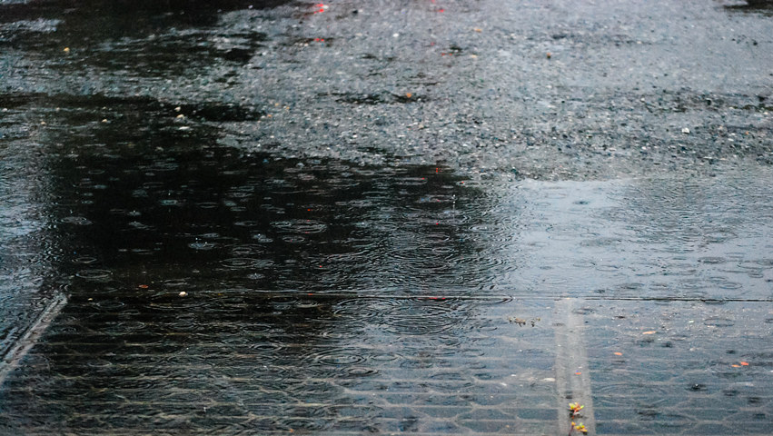
A Local Government Guide to the Chesapeake Bay
Module 6: Protecting Your Infrastructure Through Stormwater Resiliency
Notes:
Photo by M. Rath/Chesapeake Bay Program of stormwater overflowing a drain in Annapolis, MD

Slide 2
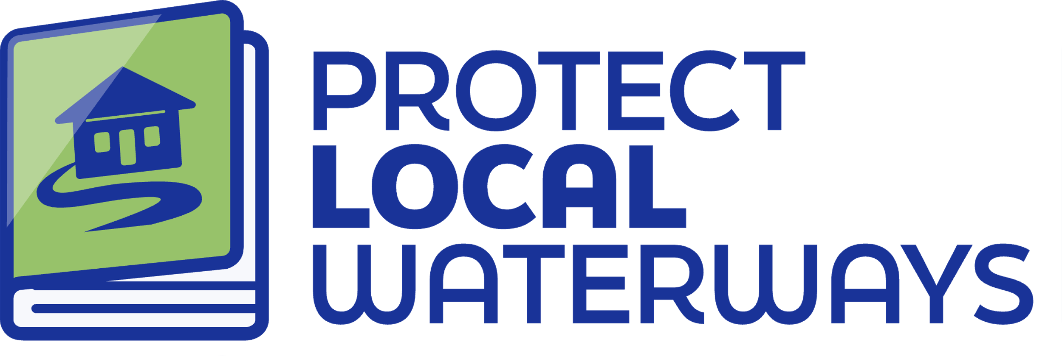
Content Developed By
A Local Government Guide to the Chesapeake Bay
Visit Us

Slide 3
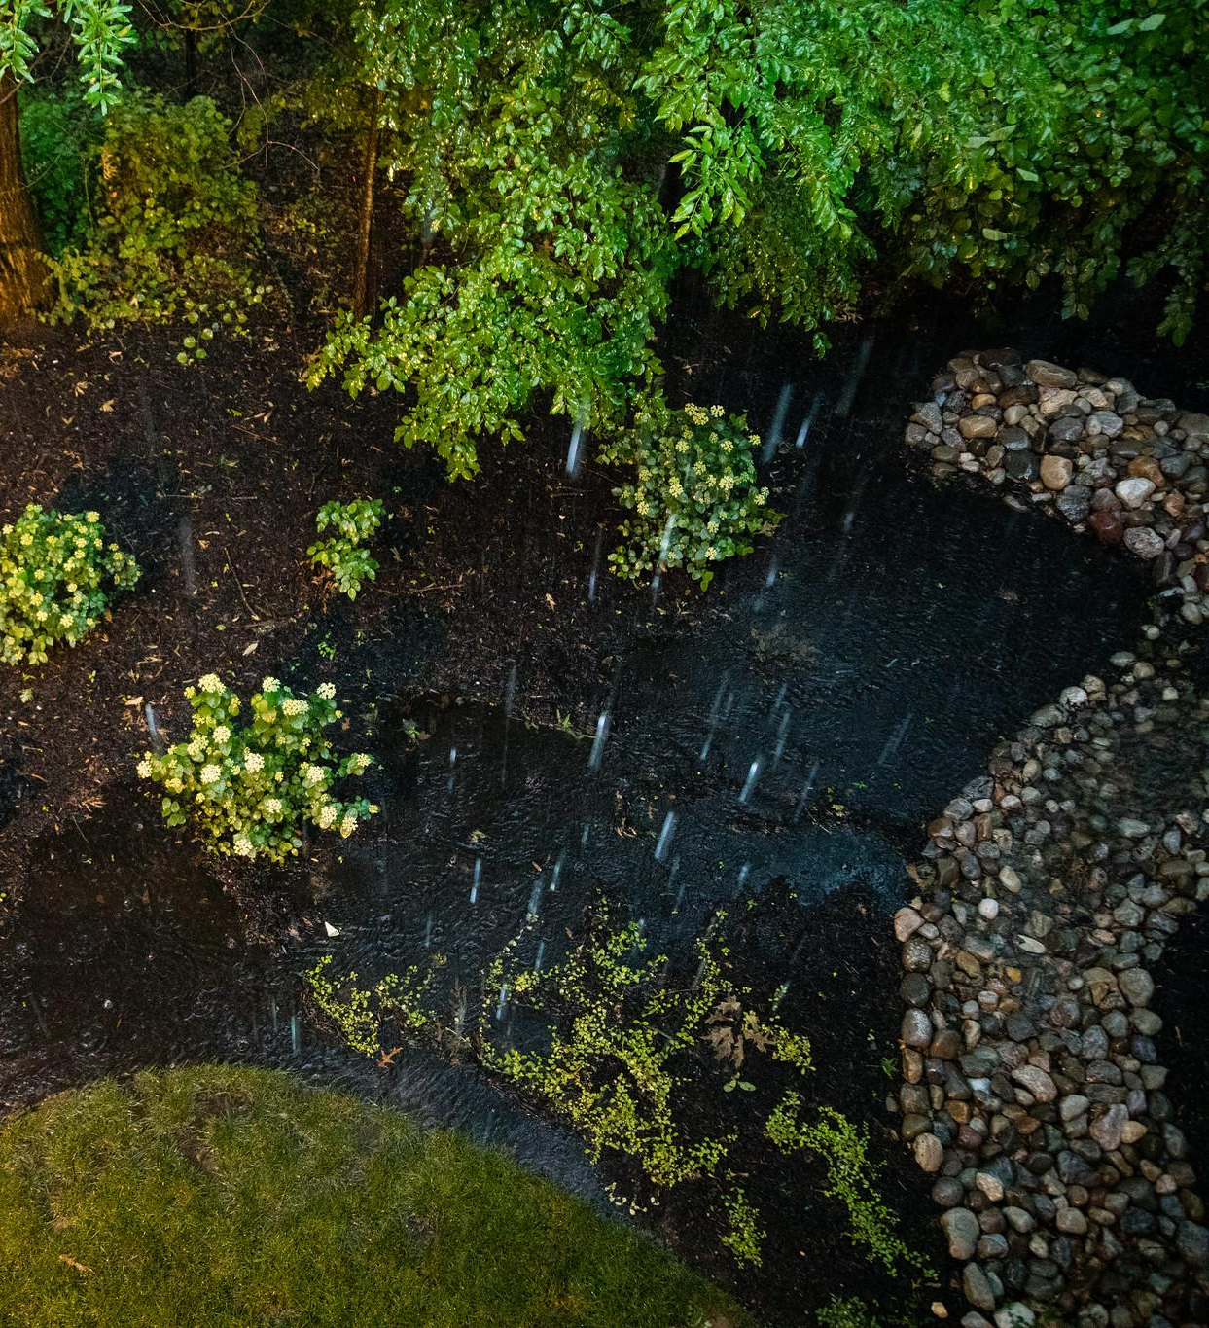
Table of Contents
1
Purpose
What You’ll Learn
Understanding Stormwater
What’s At Stake?
Stormwater Resiliency
Planning for the Future
What You Can Do
To Learn More
Glossary
2
3
4
5
6
7
8
9
*Please refer to individual slide notes for data references and information sources.
Module 6: Protecting Your Infrastructure Through Stormwater Resiliency
Notes:
Photo by W. Parson/Chesapeake Bay Program

Slide 4
A Guide For Local Governments
As a local leader, your decisions set the course for your community. Your actions determine the health and vitality of your jurisdiction, as well as that of your local waterways and the Chesapeake Bay. You can achieve win-win outcomes by prioritizing local economic development, infrastructure resiliency, public health, and education while also protecting your environment.
This module is one in a series created by the Chesapeake Bay Program to support and inform decision making by local officials. We encourage you to examine the full suite of modules:
How Your Watershed Works
Foundations of Clean Water
Healthy Water for the Economy
The Benefits of Trees
Preserving Local Character and Landscapes
Protecting Your Infrastructure Through Stormwater Resiliency
Building the Workforce of Today and Tomorrow
Preparing Your Community for Water Extremes
Understanding and Supporting Your Agricultural Allies
Keys to Community Buy-In for the Environment
Your Health and the Environment
To help local government representatives better understand how the information in the modules aligns with their priorities, look for these icons:
Economic Development
Public Health & Safety
Infrastructure Maintenance & Finance
Education
Protecting Your Infrastructure
Purpose

Slide 5
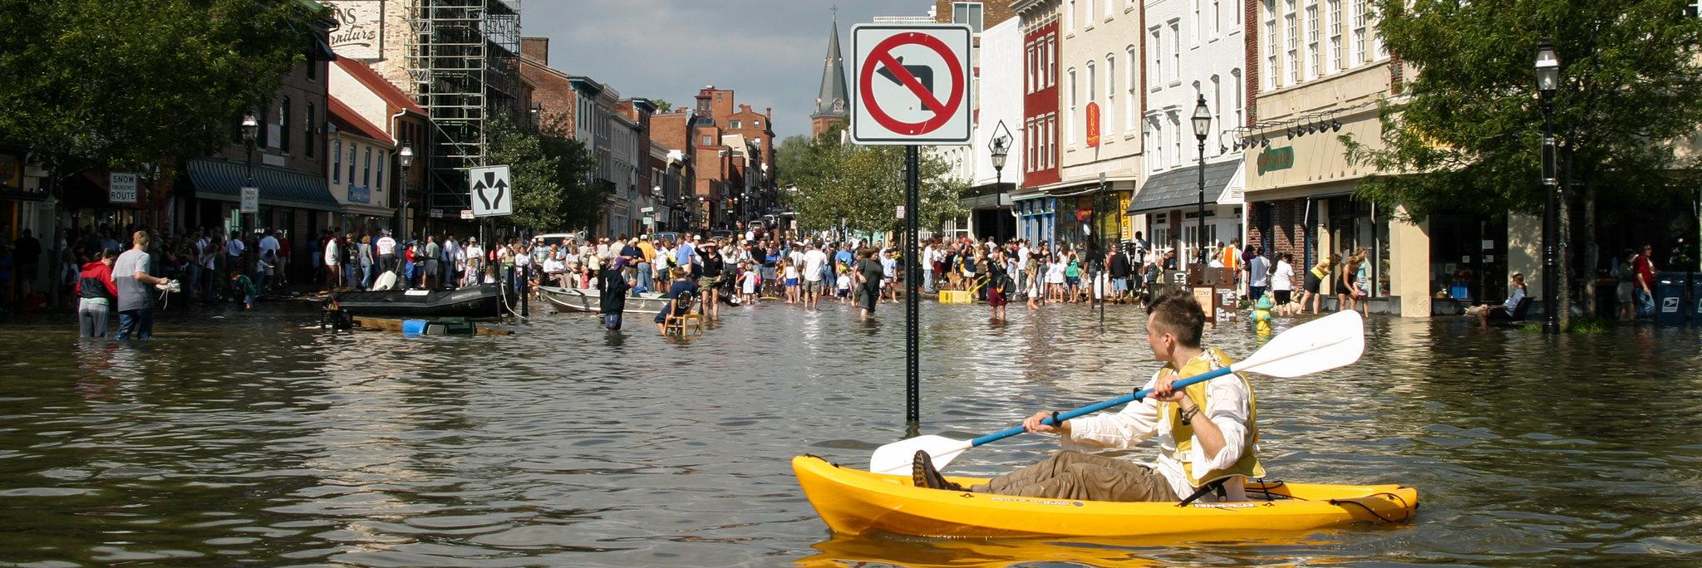
Laying Foundations
Managing stormwater runoff and increasing resiliency can mitigate flooding and flood-related damages to local community infrastructure. In addition to hazard mitigation, increasing resiliency also improves water quality. Stormwater runoff can carry bacteria, nutrients, and other pollutants into local waterways used for water supplies, fishing, swimming, and other recreational activities, posing a public health threat.
Protecting Your Infrastructure
Purpose
Notes:
Photo by M. Land/Chesapeake Bay Program

Slide 6
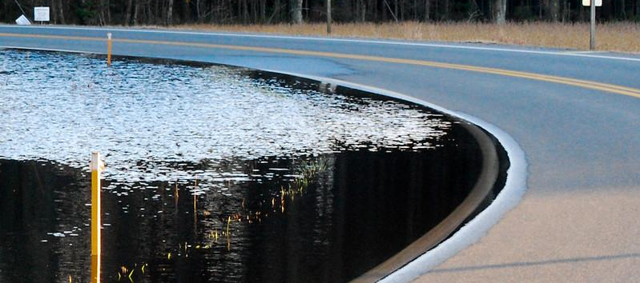
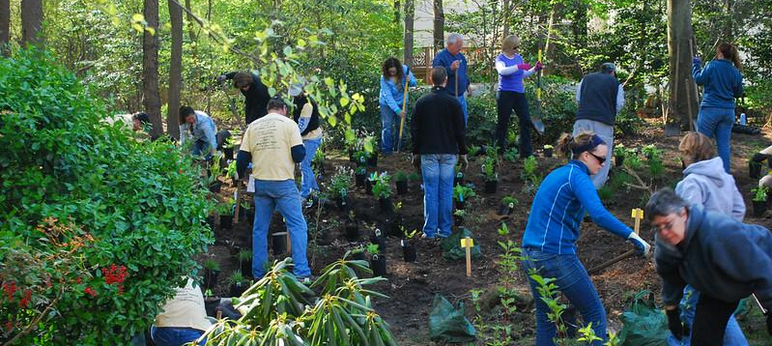
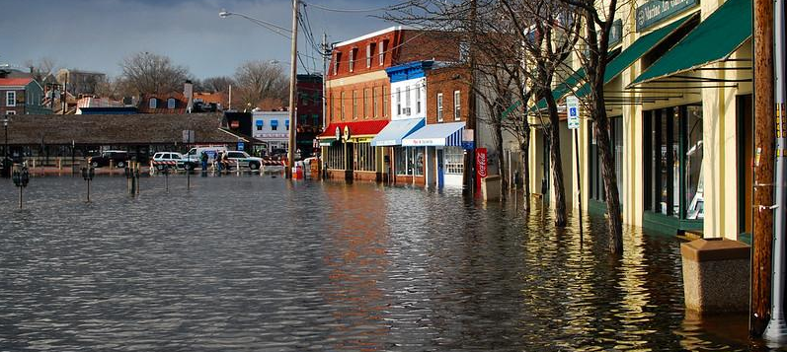
What You’ll Learn
What is stormwater and how can it be dangerous to my community?
What can I do to mitigate flood-related damage?
How will future climate conditions impact infrastructure?
Protecting Your Infrastructure
What You’ll Learn
Notes:
Photos by M. Rath/Chesapeake Bay Program

Slide 7
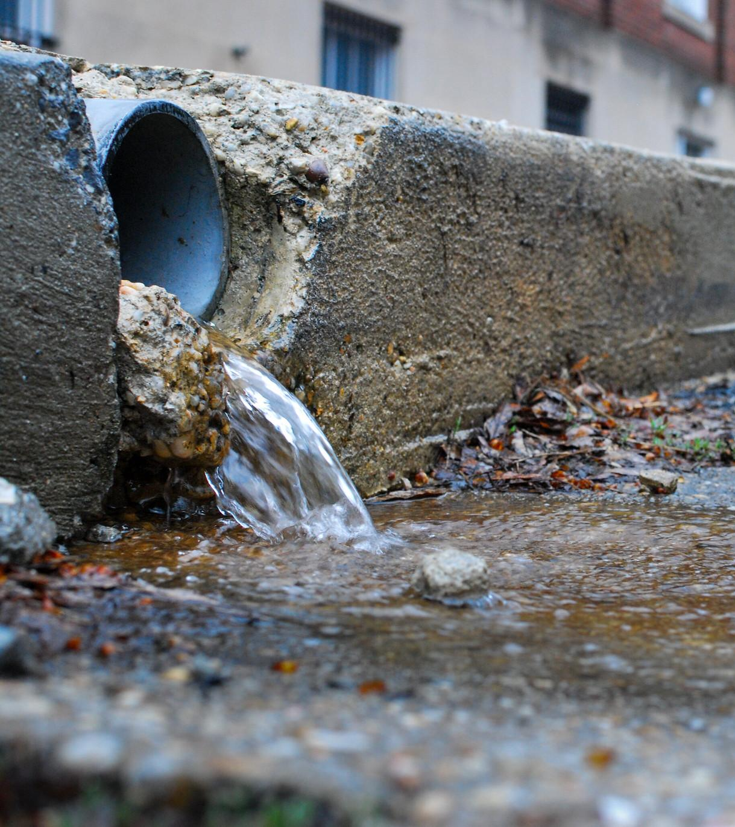
Understanding Stormwater
Rain and snow are natural phenomena. Let’s discuss how they turn into stormwater that impacts your community.
Notes:
Photo by M. Rath/Chesapeake Bay Program

Slide 8
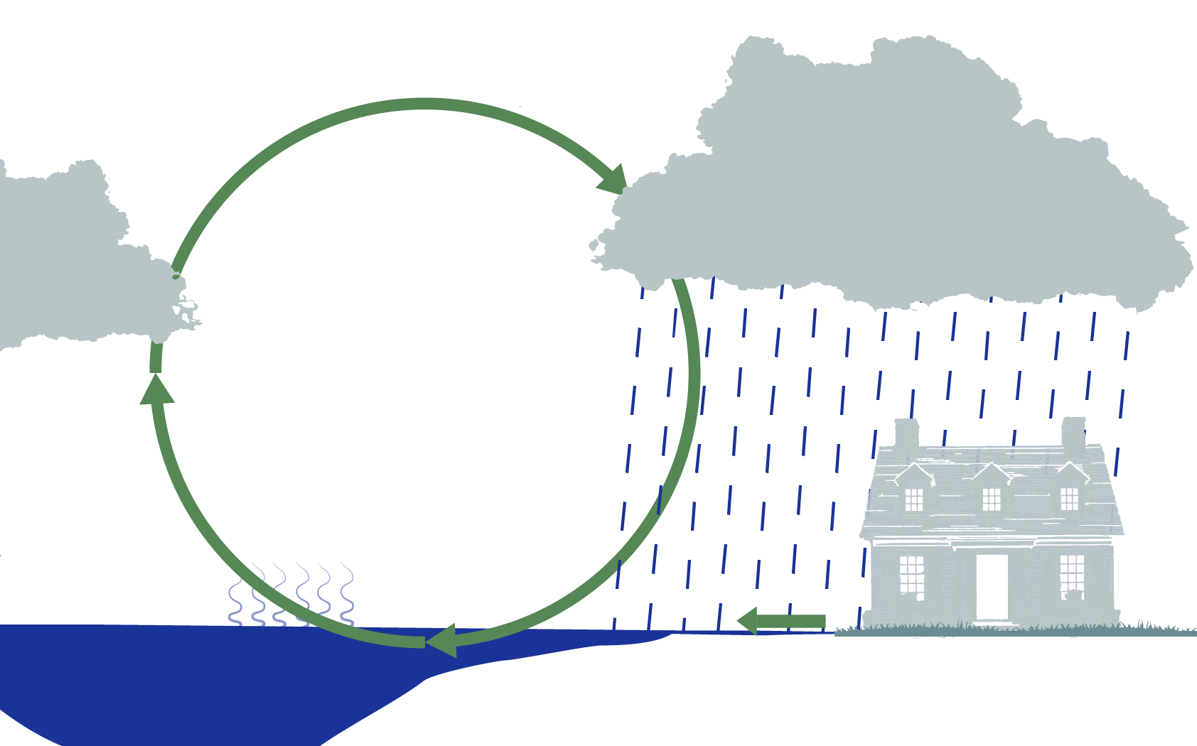
Understanding Stormwater
Stormwater is the water left over after a rainstorm or snowmelt. When we get precipitation, some of the water is absorbed into the ground. However, the water that flows down roads, across fields, out of gutters, and more is called stormwater, or runoff. Learn more through the Chesapeake Bay Program.
Condensation
Precipitation
Evaporation
Stormwater Runoff
Protecting Your Infrastructure
Understanding Stormwater

Slide 9
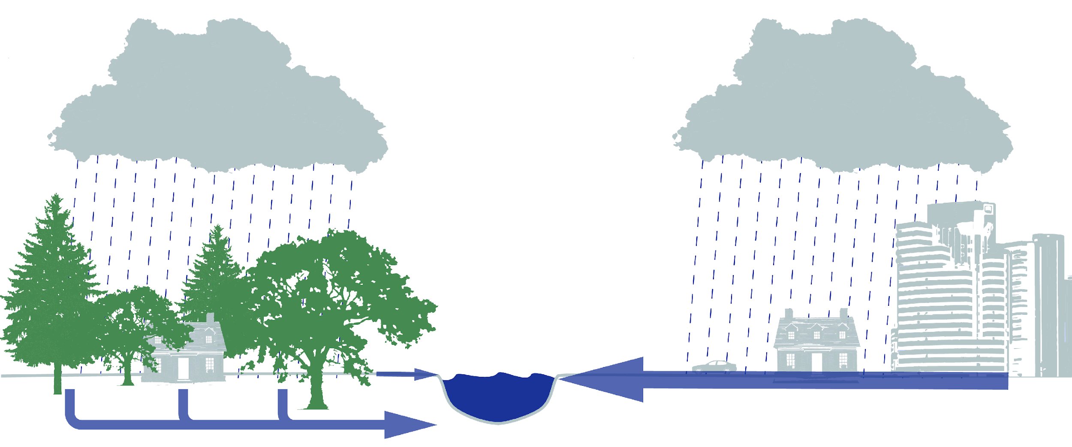
Understanding Stormwater
More impervious surfaces, or surfaces that prevent water absorption like roads and roofs, mean that less water is absorbed, and more runoff flows through your community.
RUNOFF
RUNOFF
GROUNDWATER
Nature provides cost-effective stormwater management. Forests, wetlands, and other natural landscapes absorb rainwater, where built systems lead to more runoff.
Protecting Your Infrastructure
Understanding Stormwater

Slide 10
Sewers and Stormwater
In combined systems, the storm sewer system is connected to the sanitary sewer system. A Municipal Separate Storm Sewer System (or MS4) gathers stormwater and discharges it, without treatment or combination with sanitary sewer systems, directly into local waterways. MS4 communities need a permit to discharge the untreated water, through the National Pollution Discharge Elimination System (NPDES). The permit limits what can be discharged and includes monitoring and reporting requirements to ensure sustained water quality and community health.
Only communities that the United States Census Bureau classifies as Urbanized Areas, based on population density, are required to become part of the MS4 program. Some large institutional campuses, such as colleges, hospitals, prisons and military installations, are also designated as MS4s. Other municipalities can choose to develop their own stormwater management programs.
Protecting Your Infrastructure
Understanding Stormwater
Notes:
References:
https://www.epa.gov/npdes/stormwater-discharges-municipal-sources
https://extension.psu.edu/what-is-an-ms4
Photo by A. Pimental/Chesapeake Bay Program

Slide 11
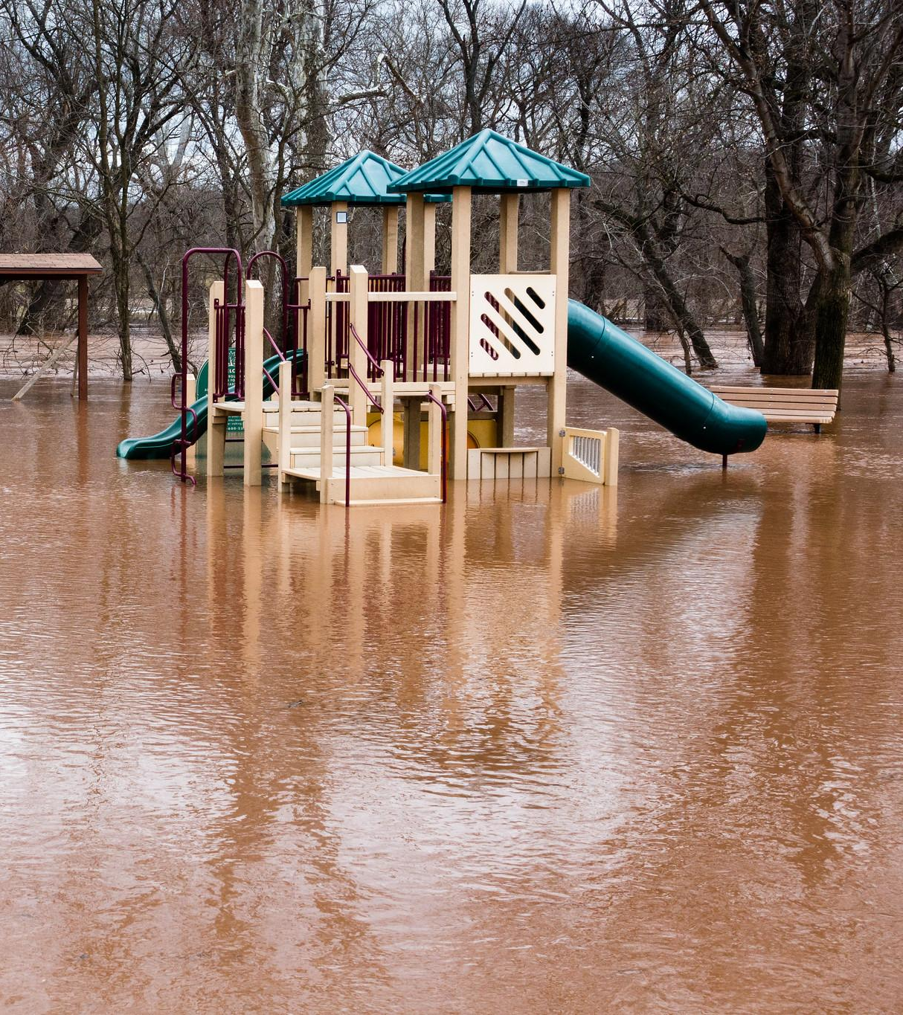
What’s At Stake?
Stormwater runoff can damage public infrastructure and private property through flooding and wash pollutants into local waterways.
Notes:
Photo by W. Parson/Chesapeake Bay Program

Slide 12
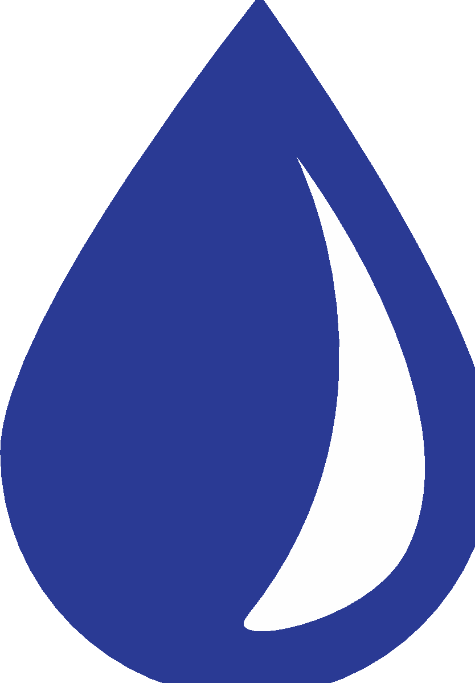
Critical Infrastructure
Flooding can endanger critical infrastructure in your community, including roads, electricity, clean water, and cellular phones.
Roads
Roads are central to schools, businesses, and emergency services. Your community needs vehicles like school buses and ambulances to be able to reach residential areas.
Electricity
Water can damage the structures needed to get electricity to residences. In addition, electricity and standing water are a dangerous combination.
Clean Water
Excess stormwater can overwhelm sewer and stormwater systems and wash pollutants into local waterways and drinking water. These pollutants, including bacteria & nutrients, can endanger your community’s health.
Cellular Networks
When electricity goes out, cellular towers must rely on batteries and/or generators, which may not outlast the power outage. Your community relies on cell phones to communicate, especially in emergency situations with no power/internet access.
Protecting Your Infrastructure
What’s At Stake?
Notes:
References:
Cellular Networks and Internet: https://www.wpowerproducts.com/news/generator-role-helping-cell-towers-during-harvey/

Slide 13
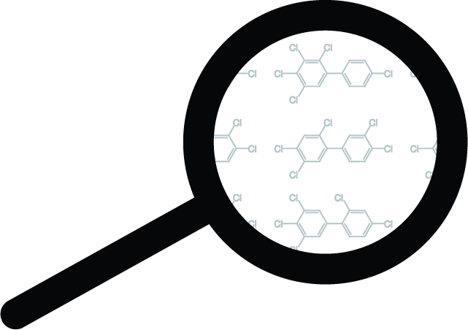
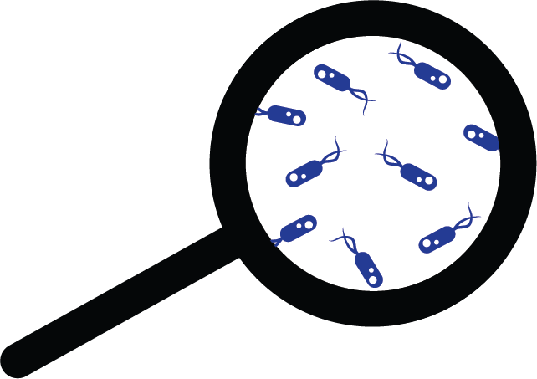
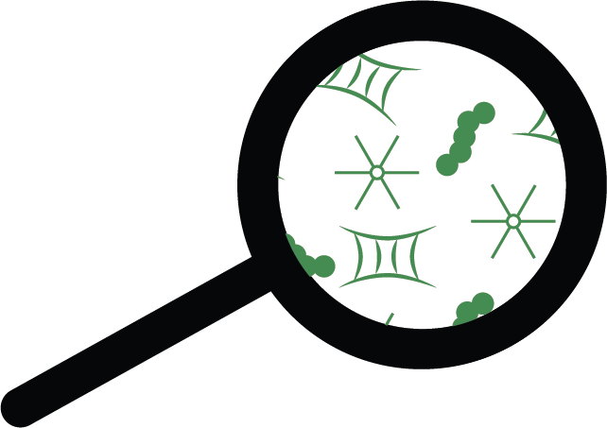
Public Health
Stormwater picks up litter and other pollutants from the land that it passes over. These pollutants include microplastics, bacteria, toxic contaminants, sediment, nutrients that fuel algae, and more. This water gets discharged directly into local waterways without treatment.
TOXIC CONTAMINANTS
BACTERIA
ALGAE
including pesticides, pharmaceuticals, heavy metals and more, and can harm human health and wildlife.
from sewage, wildlife and pet waste, and/or dead and decaying animals pose a threat to human and aquatic health.
use nutrients to grow. Excess nutrients can fuel excess algae in water bodies. When the algae die and decay, they use up oxygen and can cause fish kills. Additionally, some algae produce toxins that can harm humans and animals.
Pollution can make recreation in, on, or near water unsafe. Fish and shellfish can become unsafe to harvest and eat. Stormwater runoff can also threaten drinking water in your community or downstream.
Protecting Your Infrastructure
What’s At Stake?

Slide 14
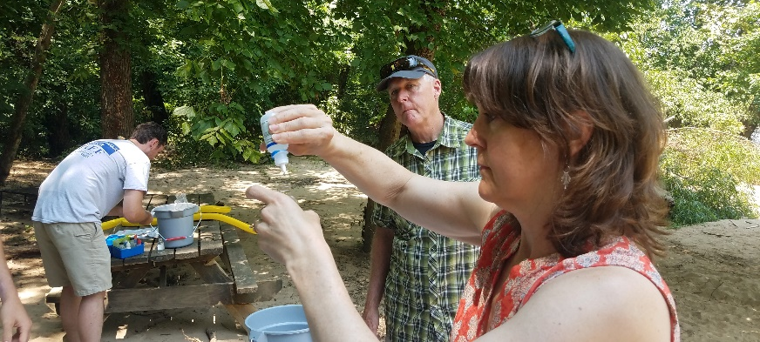
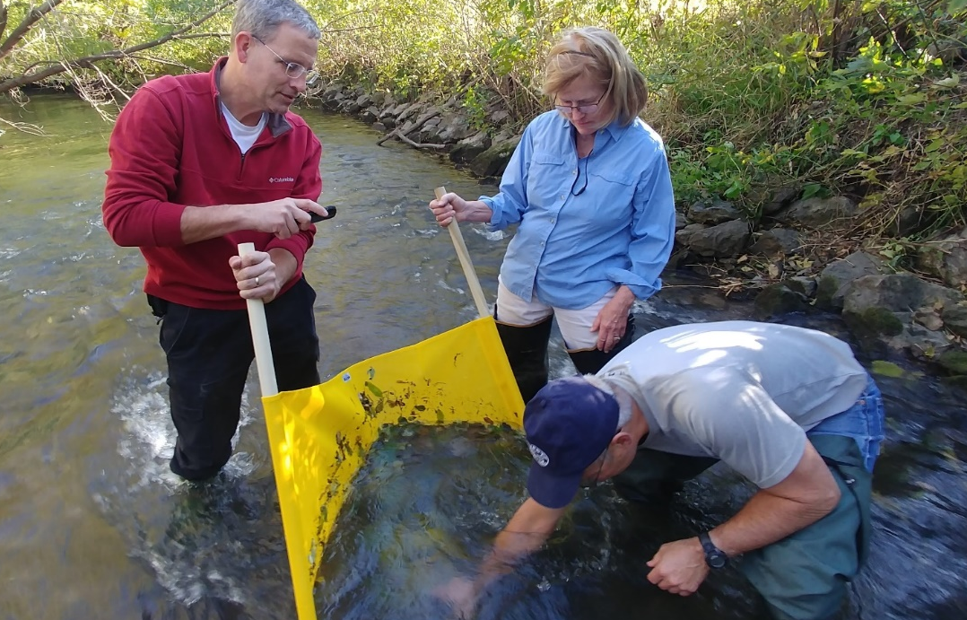
Public Health
Detecting public health threats like bacteria in local water is normally the work of public works departments. However, community partners and volunteers can also play a role.
Case study: Henrico County, VA
Chesapeake Monitoring Cooperative (CMC) participants found high levels of E. coli bacteria in a local waterway. They and their partners at the local Soil and Water Conservation District asked the Public Works Department (PWD) & Department of Public Utilities if there were broken sewer lines upstream. None were found; geese and other wildlife were suggested as the source of the bacteria.
The next spring, the monitors once again discovered high levels of bacteria. They contacted the local government departments a second time and the PWD was able to track the pollution source to a local pet daycare center that was improperly disposing of pet waste. Public Utilities worked with kennel management to educate employees and establish waste disposal techniques to eliminate this clean water threat.
The CMC works with hundreds of volunteer & citizen science groups to provide easy-to-use, quality data throughout the watershed. Check for data in your area here.
Protecting Your Infrastructure
What’s At Stake?

Slide 15
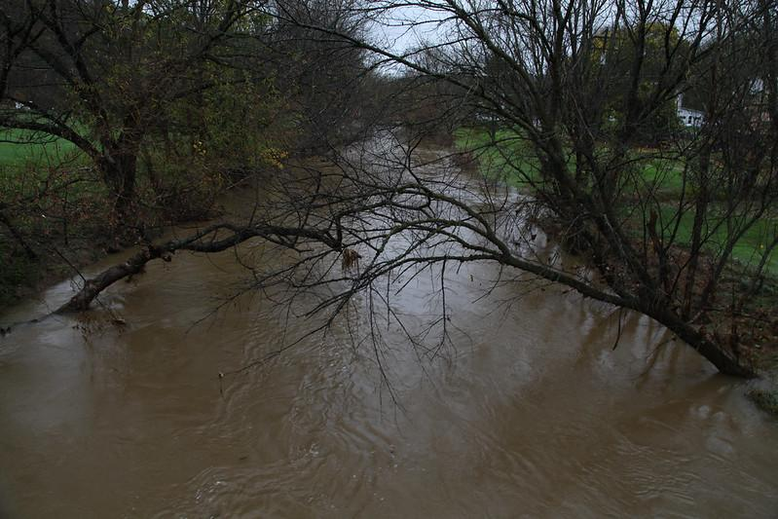
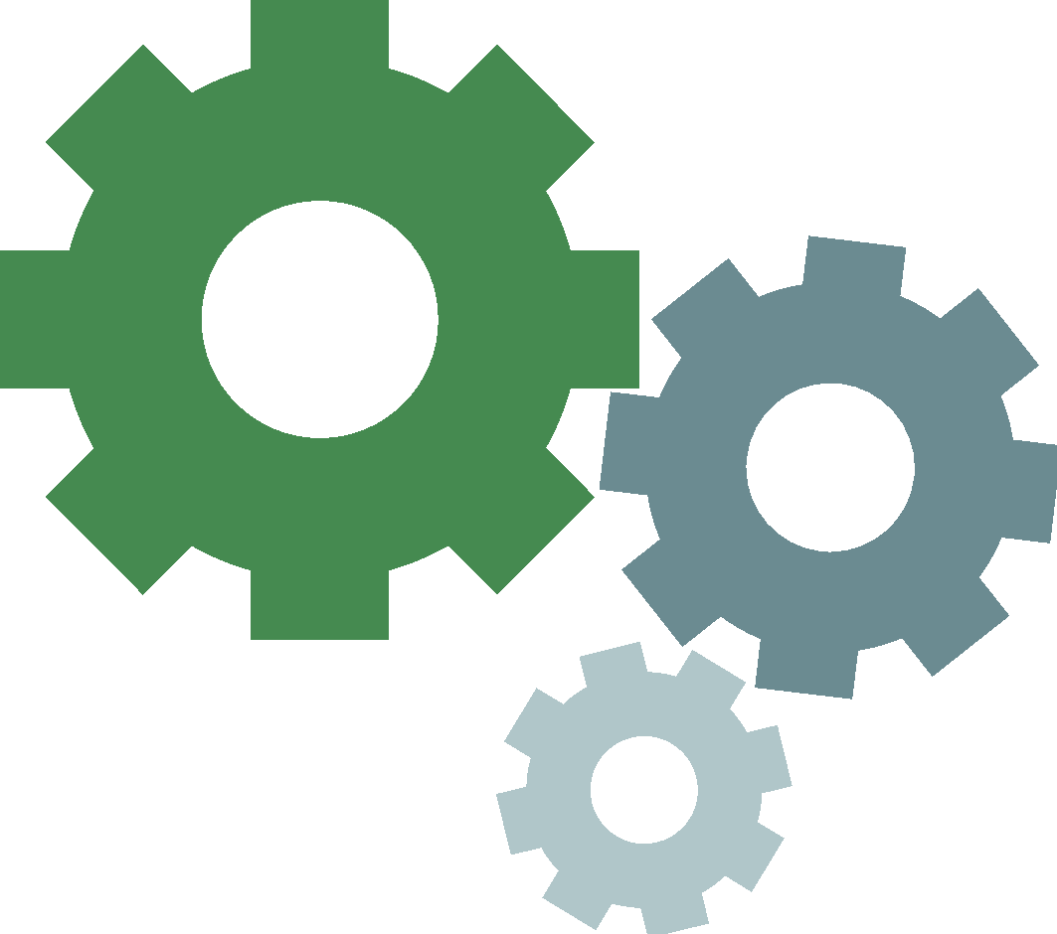
The Economy
Flooding harms businesses and private property. It also threatens the health of local waterways, which often support outdoor recreation and tourism.
Case study: Pennsylvania
Pennsylvania’s Emergency Management Agency documented over $160 million in public infrastructure damages during 2018, but only around $60 million was covered by federal disaster aid due to each of the many storms not meeting federal disaster threshold criteria on their own. The remaining $100 million in damage had to be absorbed by municipalities, counties and state agencies.
A benefit-cost analysis of natural hazard mitigation found that every $1 invested in proactive mitigation steps saves $7 in emergency response and recovery costs in the future.
Outdoor recreation relies on healthy waterways and safe access. Annually, the US outdoor recreation economy provides:
$887 BILLION
7.6 MILLION
$125 BILLION
%
1234 5678 8765 4321
in consumer spending
American jobs
in federal, state & local taxes
Protecting Your Infrastructure
What’s At Stake?
Notes:
References:
Case Study: http://www.paenvironmentdigest.com/newsletter/default.asp?NewsletterArticleID=45862&SubjectID=8
https://cdn.ymaws.com/www.nibs.org/resource/resmgr/reports/mitigation_saves_2019/mitigationsaves2019report.pdf
The Outdoor Recreation Economy (Outdoor Industry Association) https://outdoorindustry.org/resource/2017-outdoor-recreation-economy-report/
Photo by S. Droter/Chesapeake Bay Program

Slide 16
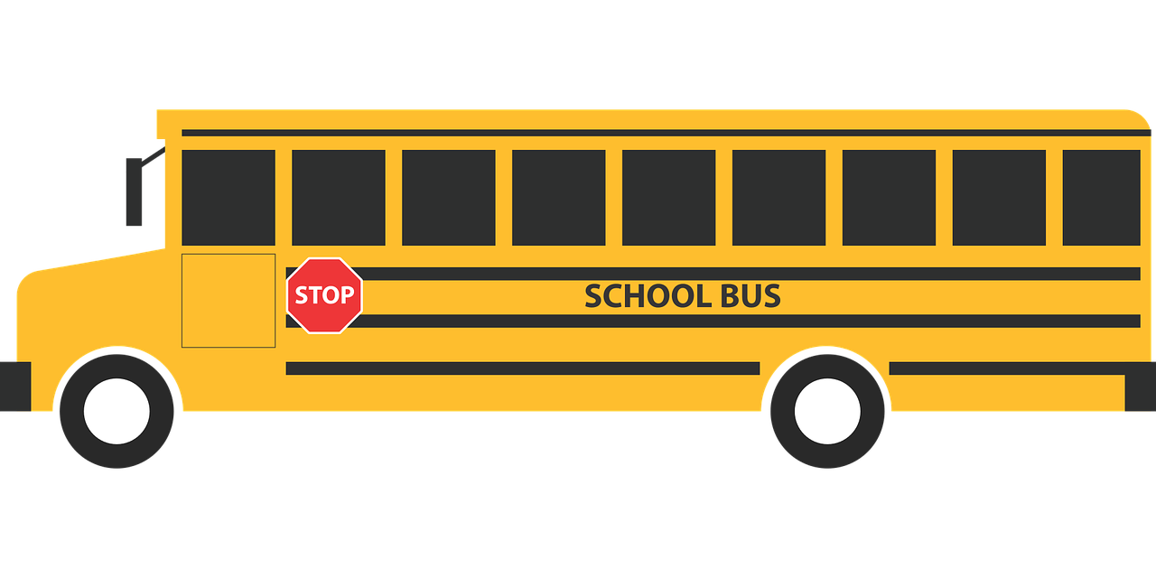
Education
Excess stormwater runoff can cause missed school days during extended closures caused by flooded or damaged school buildings, but it can also impact education through disrupted bus routes, lack of internet access for schoolwork, and other infrastructural impacts.
While only 2% of Mid-Atlantic schools are in a flood zone, 10% of Mid-Atlantic students’ ZIP codes are in a flood zone. This means that even if a school building is not impacted by flooding, students may not be able to attend school because of flooding at or near their homes.
Protecting Your Infrastructure
What’s At Stake?
Notes:
References:
https://www.pewtrusts.org/~/media/assets/2017/08/fpc_flooding_threatens_public_schools_across_the_country.pdf
Photo from Pixabay.com

Slide 17
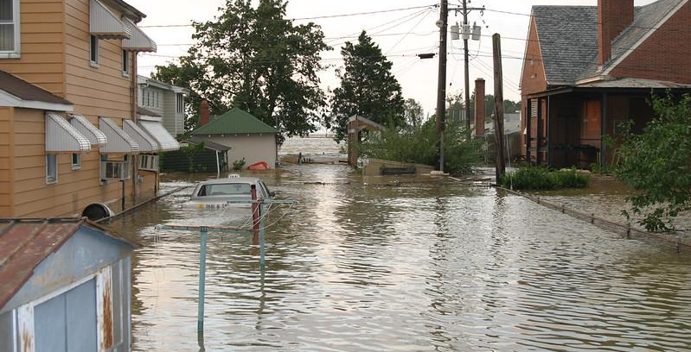
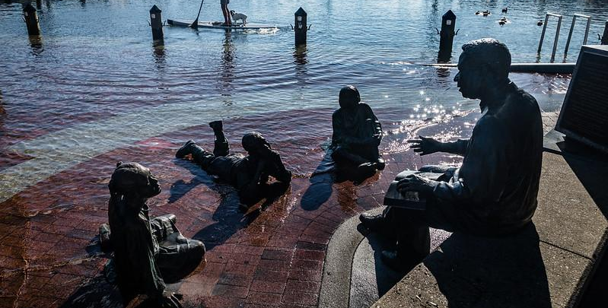
Diversity, Equity, Inclusion, and Justice
While flooding affects a wide range of demographics, it is most harmful to communities of color, low-income residents, and others who do not have the resources to handle the damage and disruption that flooding causes.
Flooding in the U.S. disproportionately harms African American neighborhoods based on an analysis of federal flood insurance payments. Those without flood insurance are not included in those numbers.
Protecting Your Infrastructure
What’s At Stake?
Notes:
References:
Flooding Disproportionally Harms Black Neighborhoods, Scientific American: https://www.scientificamerican.com/article/flooding-disproportionately-harms-black-neighborhoods/#:~:text=A%20report%20published%20in%20March,handle%20the%20damage%20and%20disruption
Photos by M. Land and W. Parson (Chesapeake Bay Program)

Slide 18
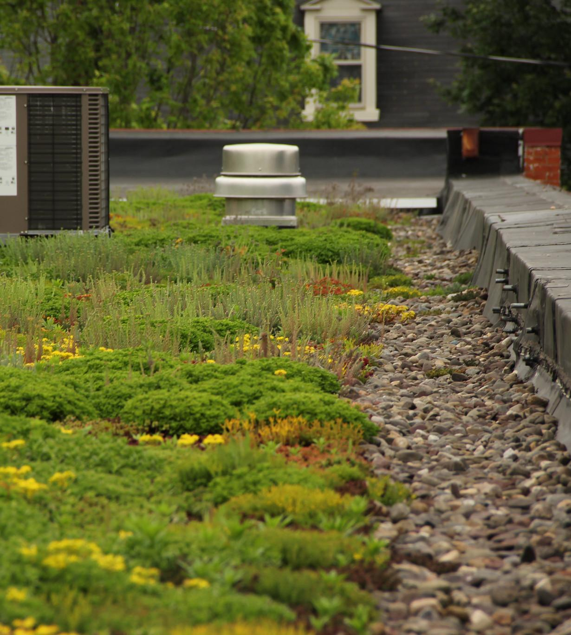
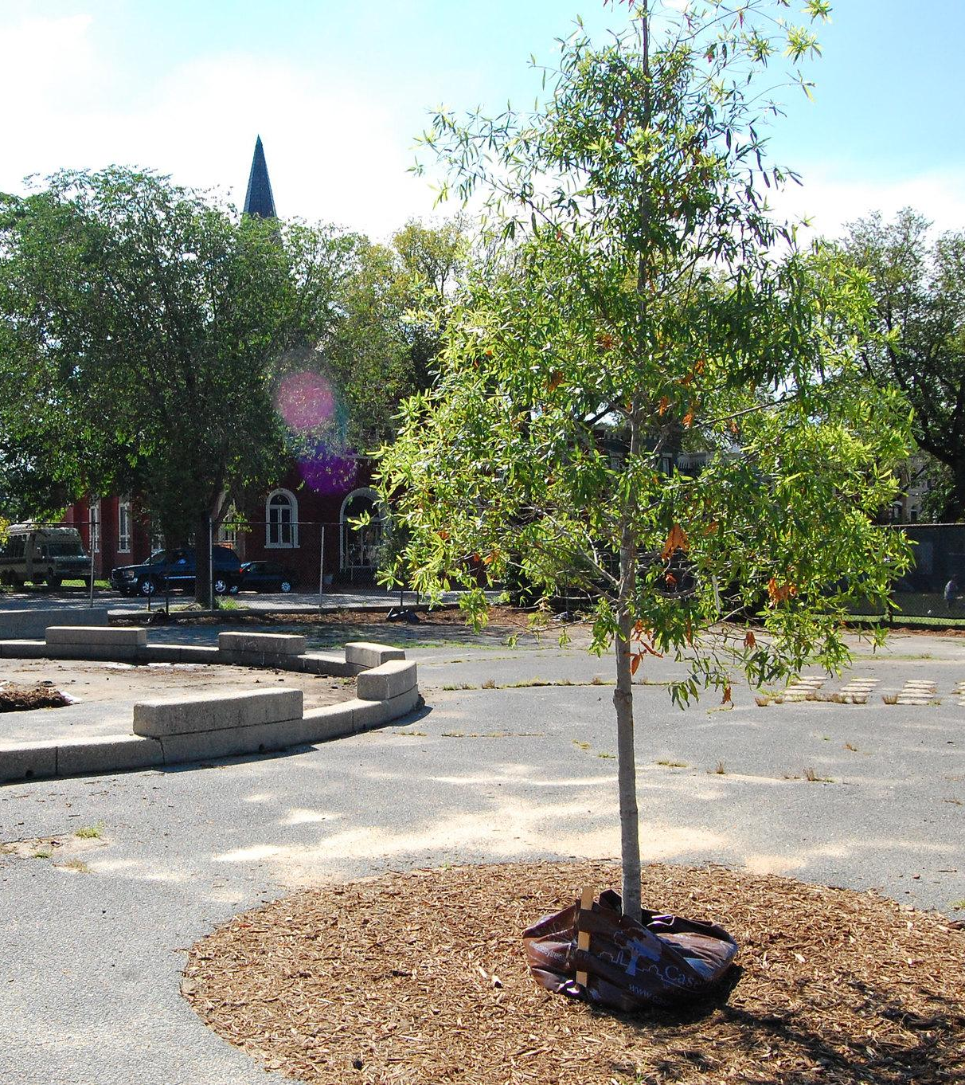
Stormwater Resiliency
Let’s talk best practices and tools to increase your community’s resiliency.
Notes:
Photo by S. Droter/Chesapeake Bay Program

Slide 19
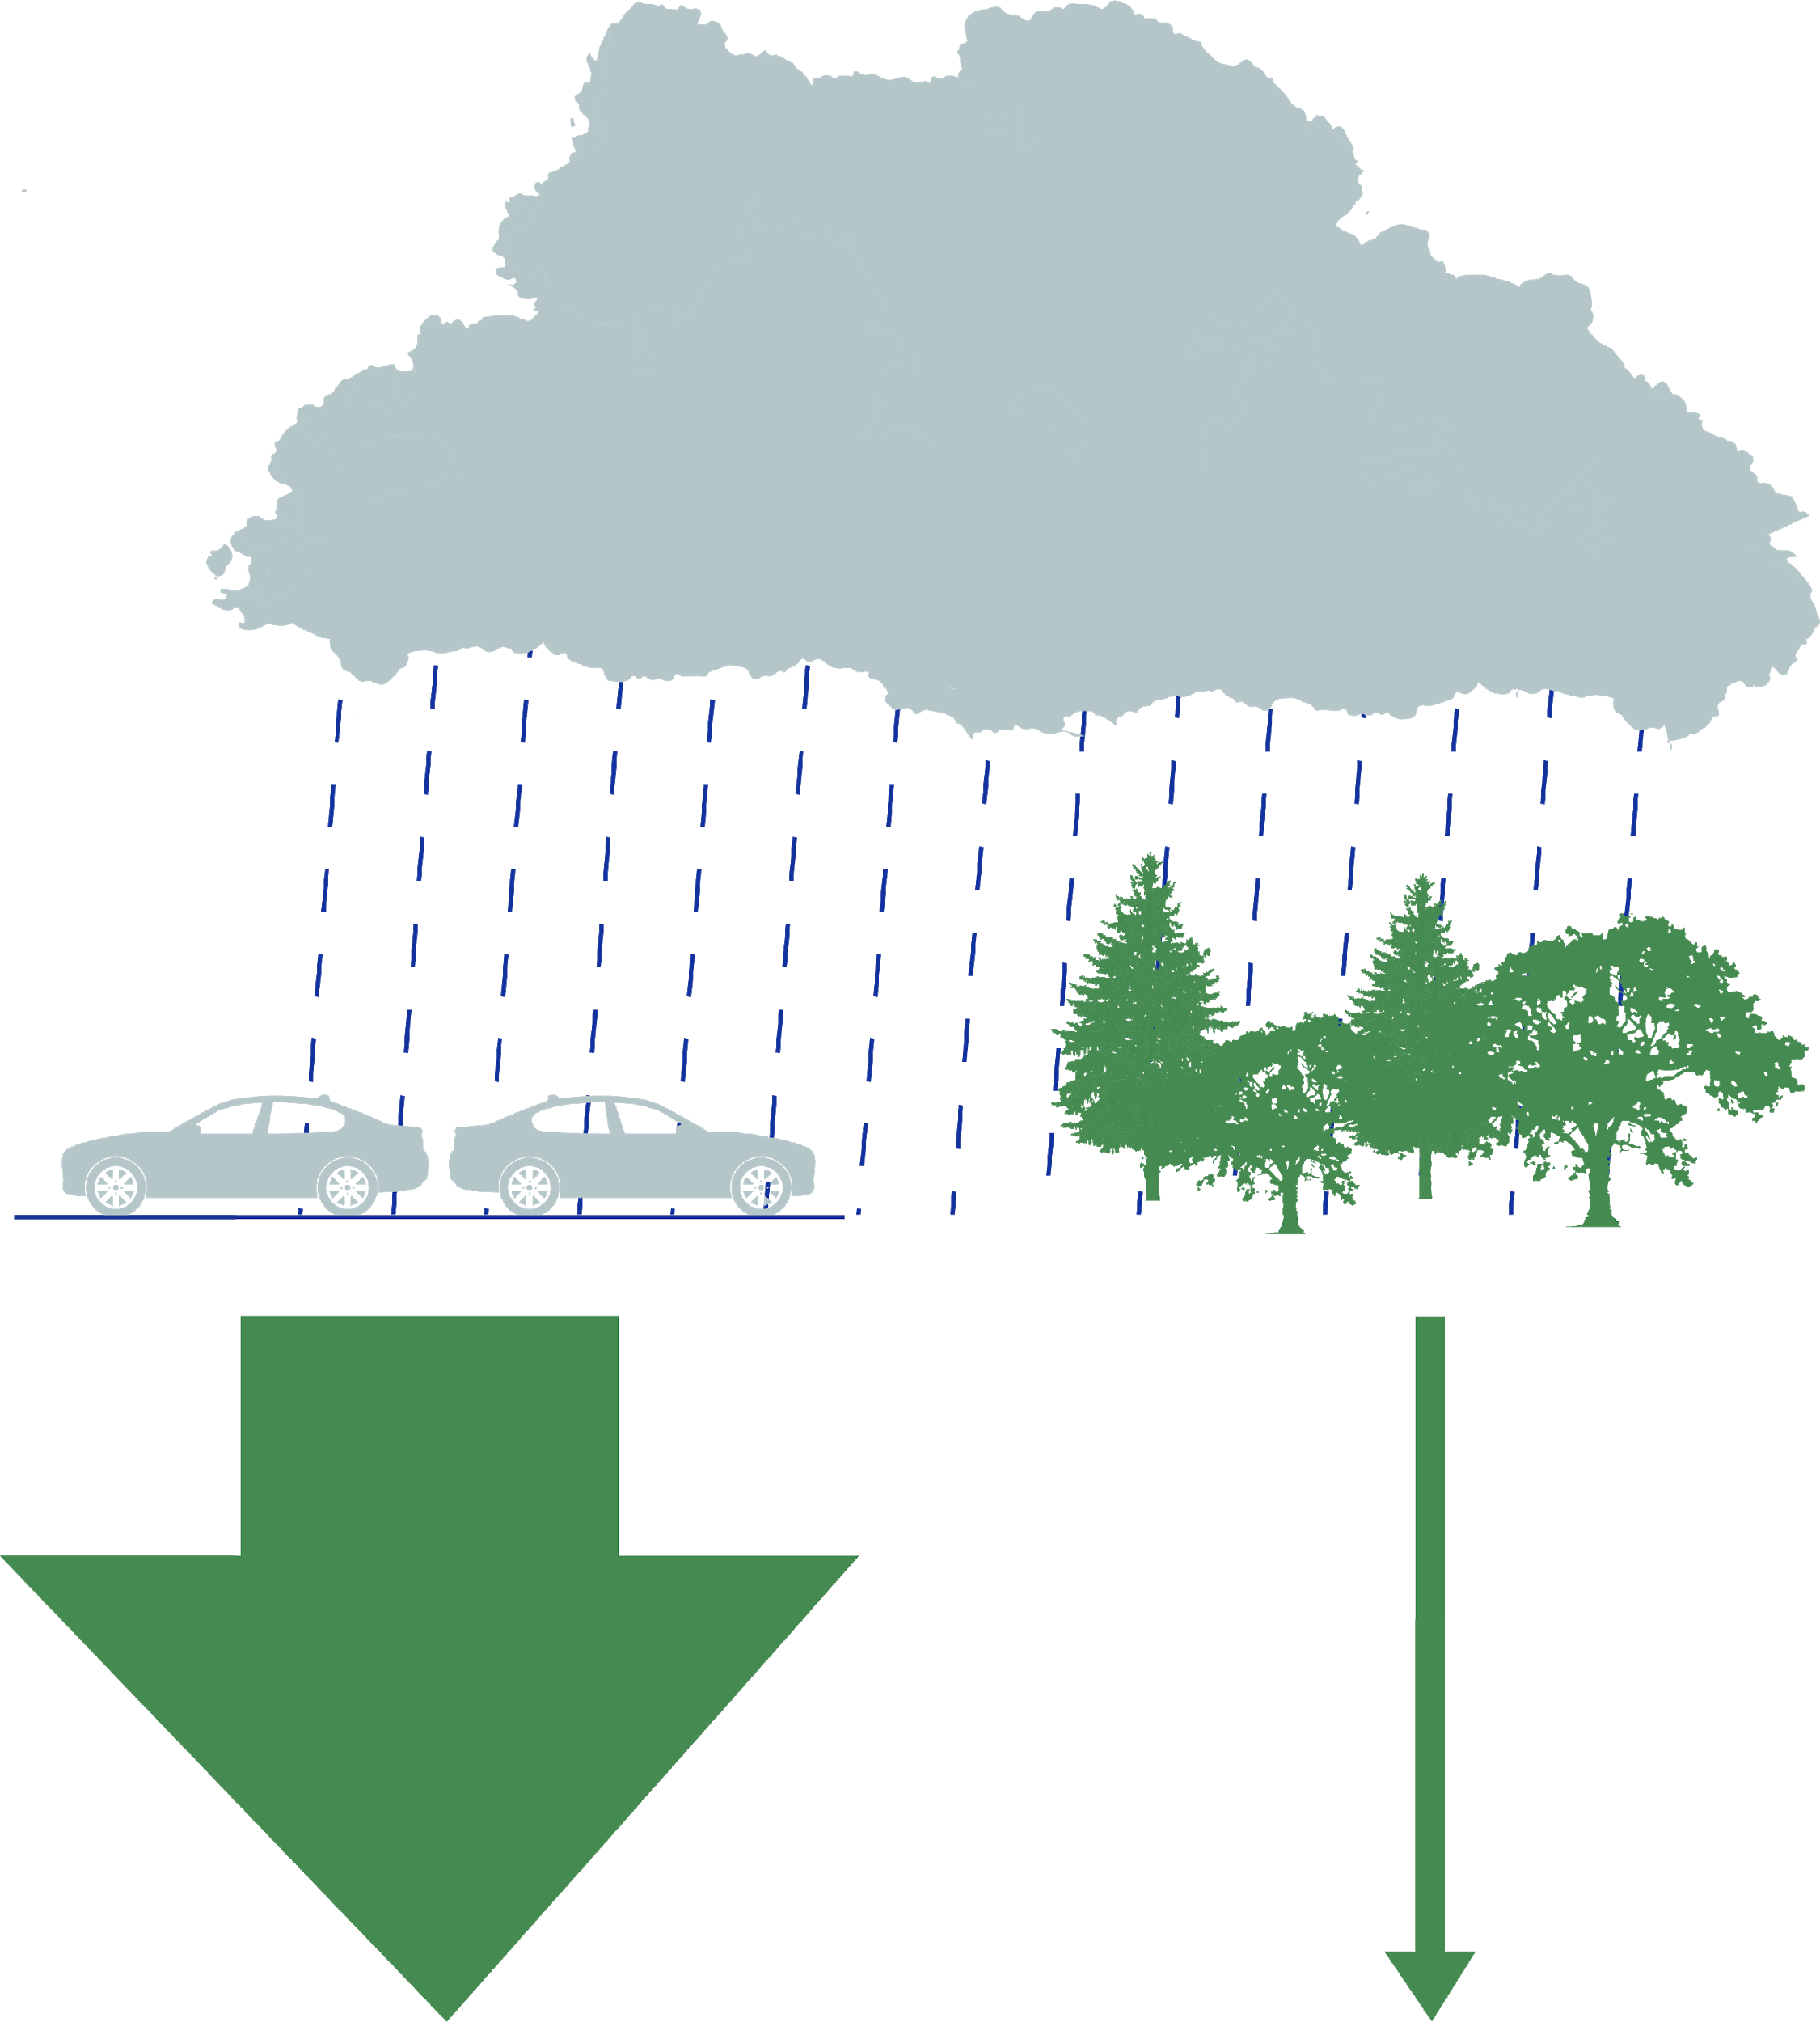
Natural Landscapes
Natural landscapes, like forests and wetlands (see next slide), reduce the amount of runoff that your community experiences. As your community develops and more parking lots, roofs, and roads are built, keep in mind that losing natural landscapes and increasing impervious surfaces have negative impacts on stormwater resilience. Develop a plan to mitigate these increases in stormwater to keep your community resilient.
One inch of rain
one acre
of forest or wetland
one acre of parking lot
750
gallons
of runoff
27,000
gallons
of runoff
Protecting Your Infrastructure
Stormwater Resiliency
Notes:
References:
https://extension.psu.edu/the-role-of-trees-and-forests-in-healthy-watersheds

Slide 20
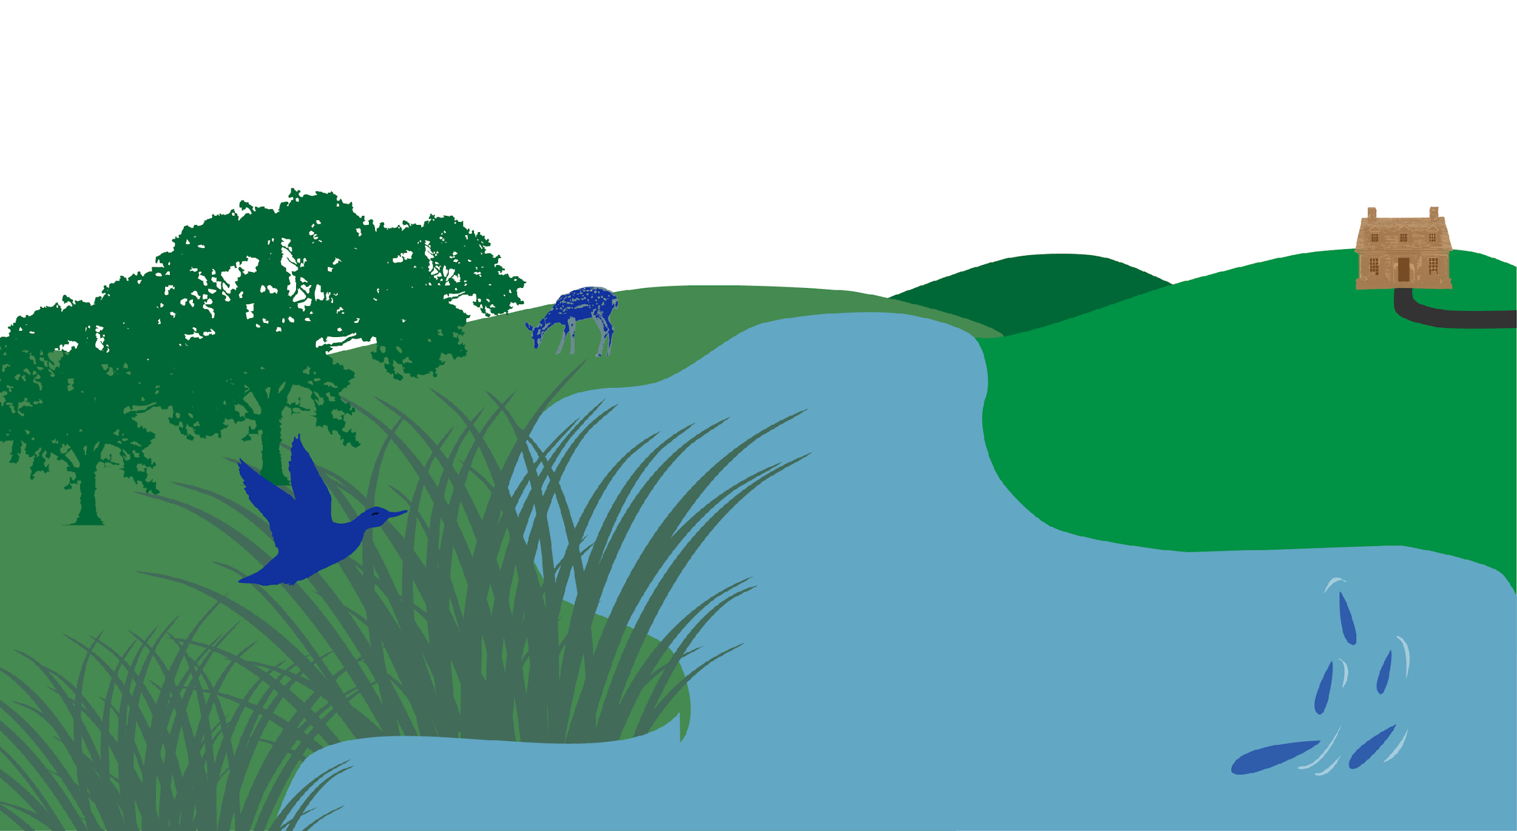
Wetlands
Wetlands are nature’s flood insurance. Wetlands capture, filter, hold, and slowly release runoff, like a giant sponge, and can prevent damage to the surrounding infrastructure. By slowing runoff entering rivers and streams, wetlands also slow the erosion of shorelines.
In MD,
wetlands reduced
property damages
from Hurricane
Sandy by nearly
30%
Protecting Your Infrastructure
Stormwater Resiliency
Notes:
References:
https://www.chesapeakebay.net/channel_files/26661/wetland_tempate_final_2.8.18.pdf
https://www.epa.gov/sites/production/files/2015-10/documents/economic_benefits_factsheet3.pdf
https://news.ucsc.edu/2016/10/coastal-wetlands.html

Slide 21
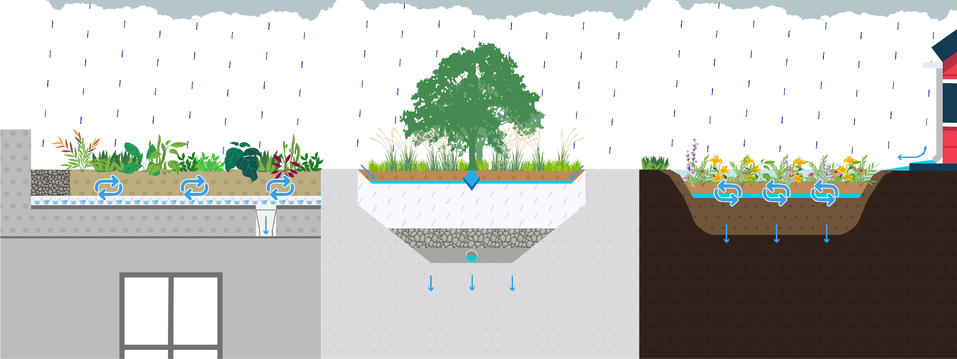
Green Infrastructure
Green infrastructure uses natural processes and technology inspired by nature to reduce runoff flows. It often has lower capital costs and public expenditures than traditional grey infrastructure. Green-gray approaches that incorporate some green practices into existing gray infrastructure can save money as well. Lastly, green infrastructure improves community aesthetics. Examples of green infrastructure include:
Excess water into stormwater system
Green Roofs
Bioswales
Rain Gardens
Protecting Your Infrastructure
Stormwater Resiliency
Notes:
References:
https://www.epa.gov/green-infrastructure/benefits-green-infrastructure#communities

Slide 22
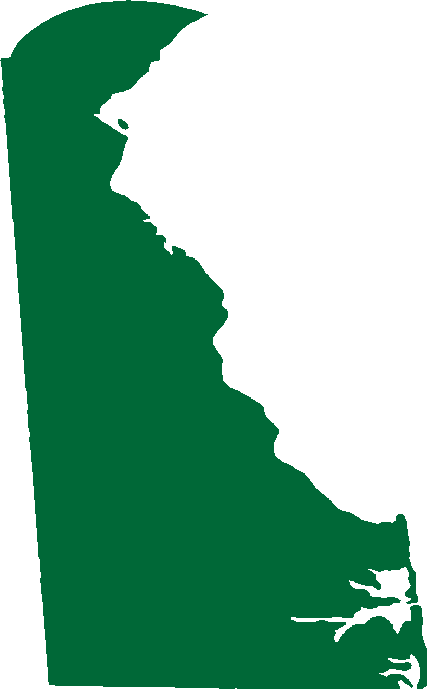
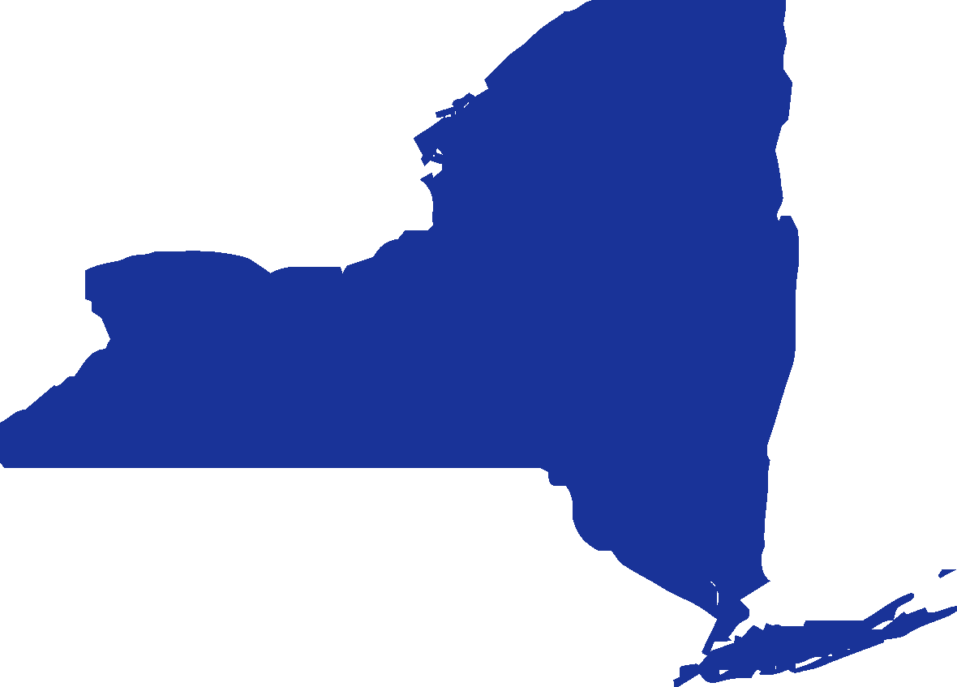
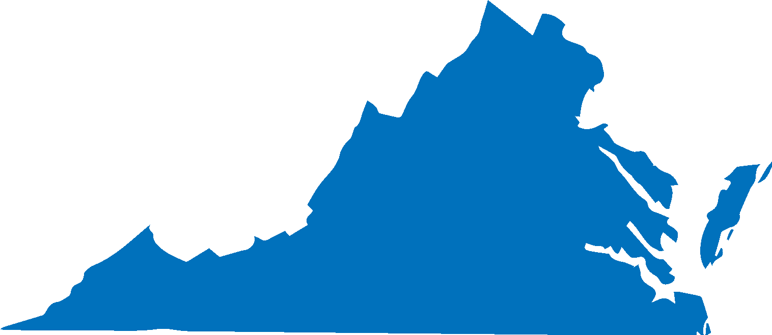
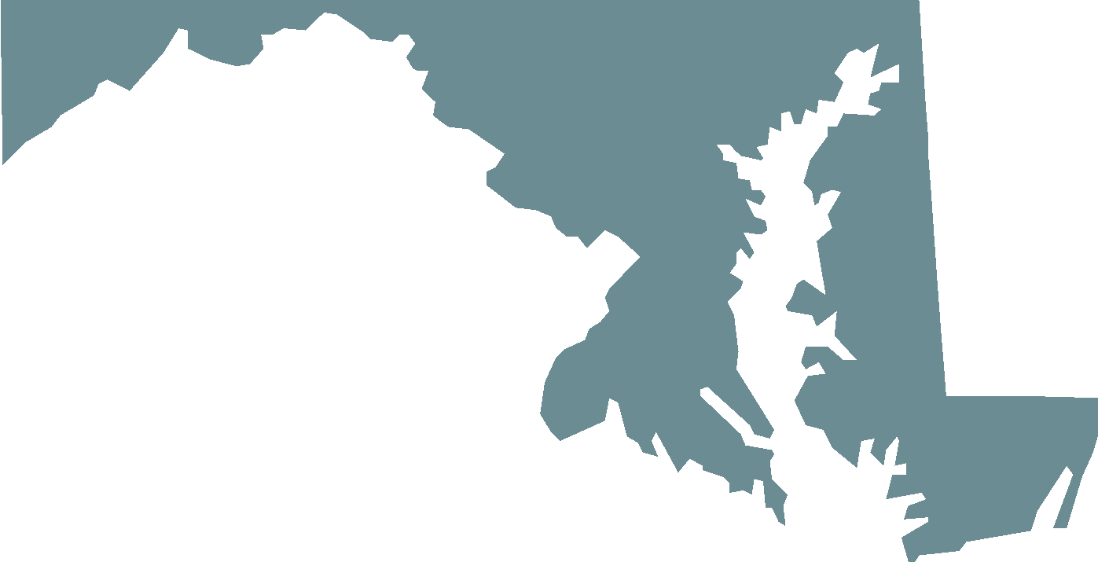
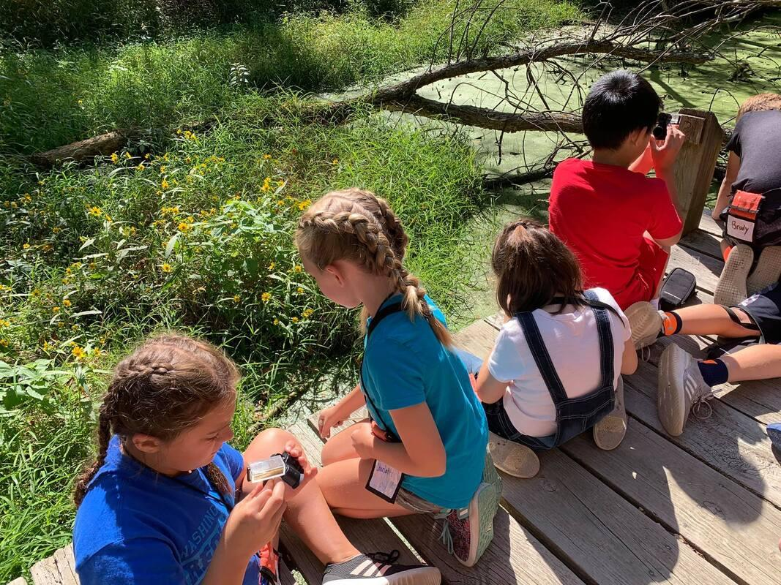
Sustainable Schools
Schools, including those that are stand-alone MS4s, provide opportunities for the installation of best management practices (known as BMPs) while providing learning opportunities for students.
Learn about sustainable school resources in your jurisdiction:
DC
DE
MD
NY
PA
VA
WV
Case study: Clear Spring, MD
The Claud E. Kitchens Outdoor School was experiencing flooding on their front lawn, driveway, and at the building entrance that caused dangerous ice in the winter. A $10,000 under-road culvert was proposed as a solution.
Instead, the school used a $5,000 grant from the National Fish & Wildlife Foundation and Chesapeake Bay Trust to educate teachers about stormwater runoff and a rain garden was installed. The rain garden not only diverts runoff from 90% of all rain events, but also serves as an outdoor teaching tool.
Protecting Your Infrastructure
Stormwater Resiliency
Notes:
References:
https://mostcenter.umd.edu/case-story-content/raining-classrooms-claud-e-kitchens-outdoor-school
https://www.chesapeakebay.net/documents/22070/2018-2019_sustainable_schools_management_strategy.pdf
Photo from Claud E. Kitchens Outdoor School; http://claudekitchensoutdoorschoolatfai.weebly.com/what-a-day-looks-like-through-the-eyes-of-a-5th-grader.html

Slide 23
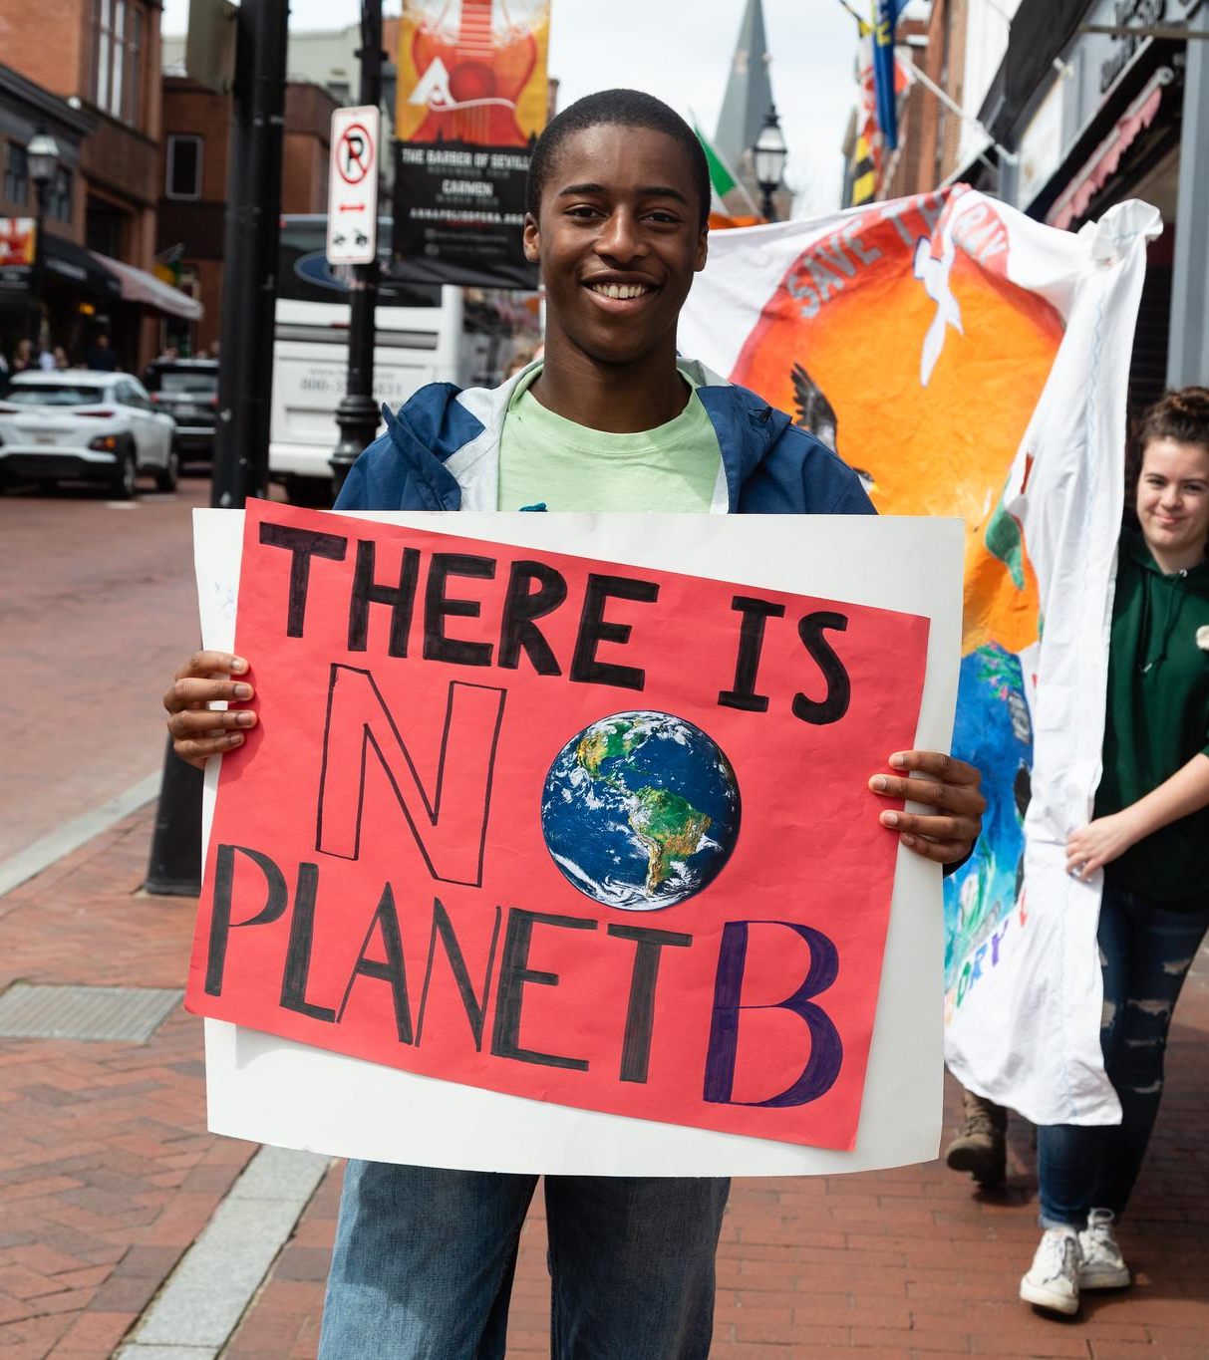
Planning for the Future
Precipitation patterns and water levels are expected to shift in the coming years. Is your community ready?
Notes:
Photo by W. Parson/Chesapeake Bay Program

Slide 24
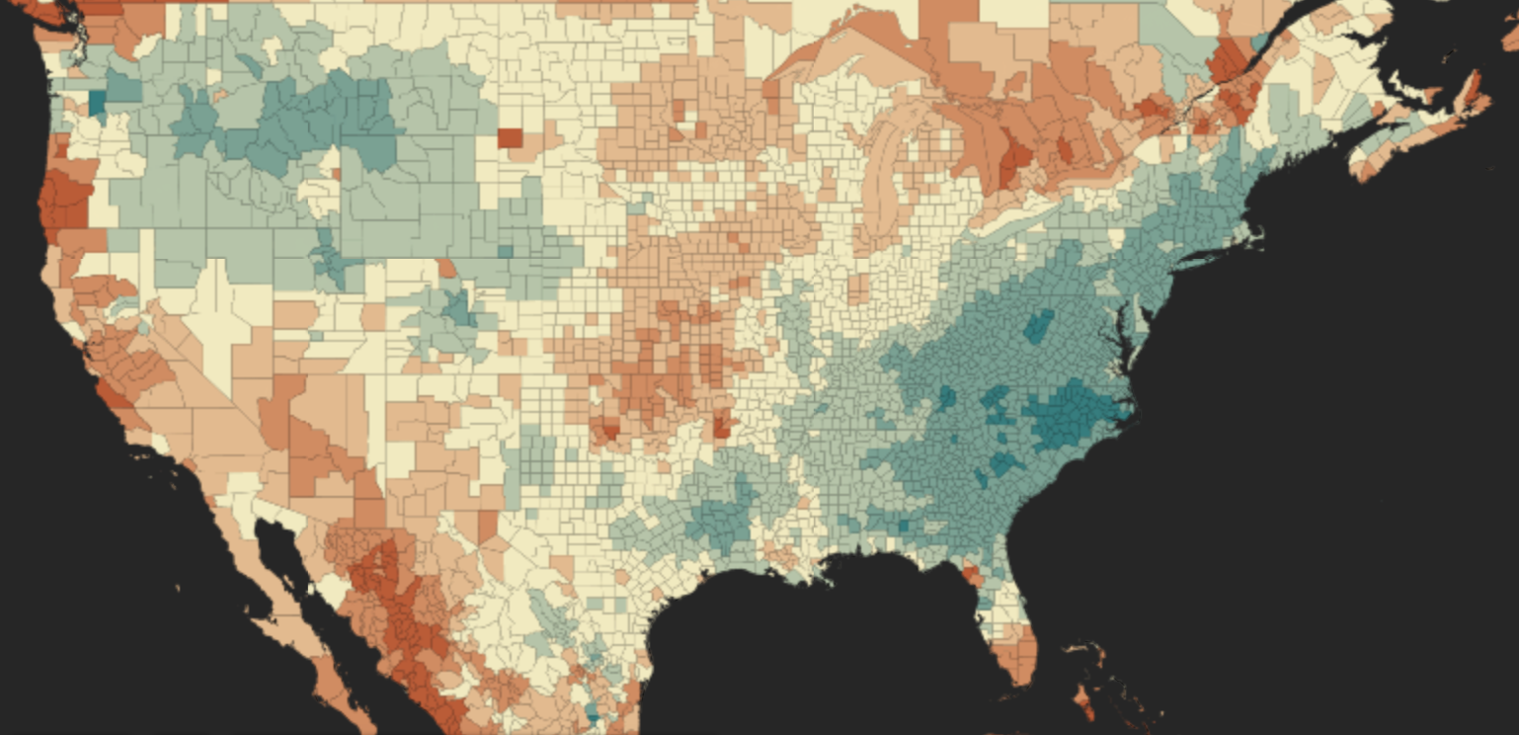
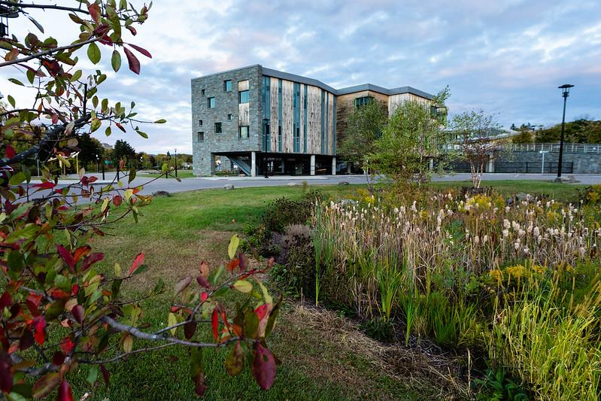
Planning for More Rain
The National Oceanic and Atmospheric Administration (NOAA) expects extreme precipitation events to continue becoming more frequent. The increase in stormwater will likely overwhelm the capacity of current municipal stormwater management systems, leading to flooding and greater runoff of pollutants into local
+ increase
- decrease
Use this interactive map to find your county’s projected precipitation.
waterways. Adapting may mean
building back differently after flood damage, not replacing the same culvert or pipe that failed.
Case study: Binghamton, NY
After record-breaking floods in 2005 and 2011 that caused $675 million in property damages, Binghamton set its sights on flood resiliency. Over 170 flood-mitigation projects are in motion with funding from federal agencies (like FEMA), community development block grants, municipalities, and school districts. The projects include:
buying out homes in floodplains and replacing them with open spaces like parks, greenways, and an urban garden;
building new, flood-resistant buildings, like the stilted school with rain gardens and bioswales pictured on the left; and
elevating essential infrastructure, like sewage treatment pumps.
Protecting Your Infrastructure
Planning for the Future
Notes:
References:
https://www.climate.gov/news-features/featured-images/prepare-more-downpours-heavy-rain-has-increased-across-most-united-0
Floods drive Binghamton toward sea change of resiliency by Ad Crable, Bay Journal December 2020 https://www.bayjournal.com/eedition/page-16/page_4b7f4d42-7047-509f-a7bc-fae17293d235.html
Photo by W. Parson/Chesapeake Bay Program

Slide 25
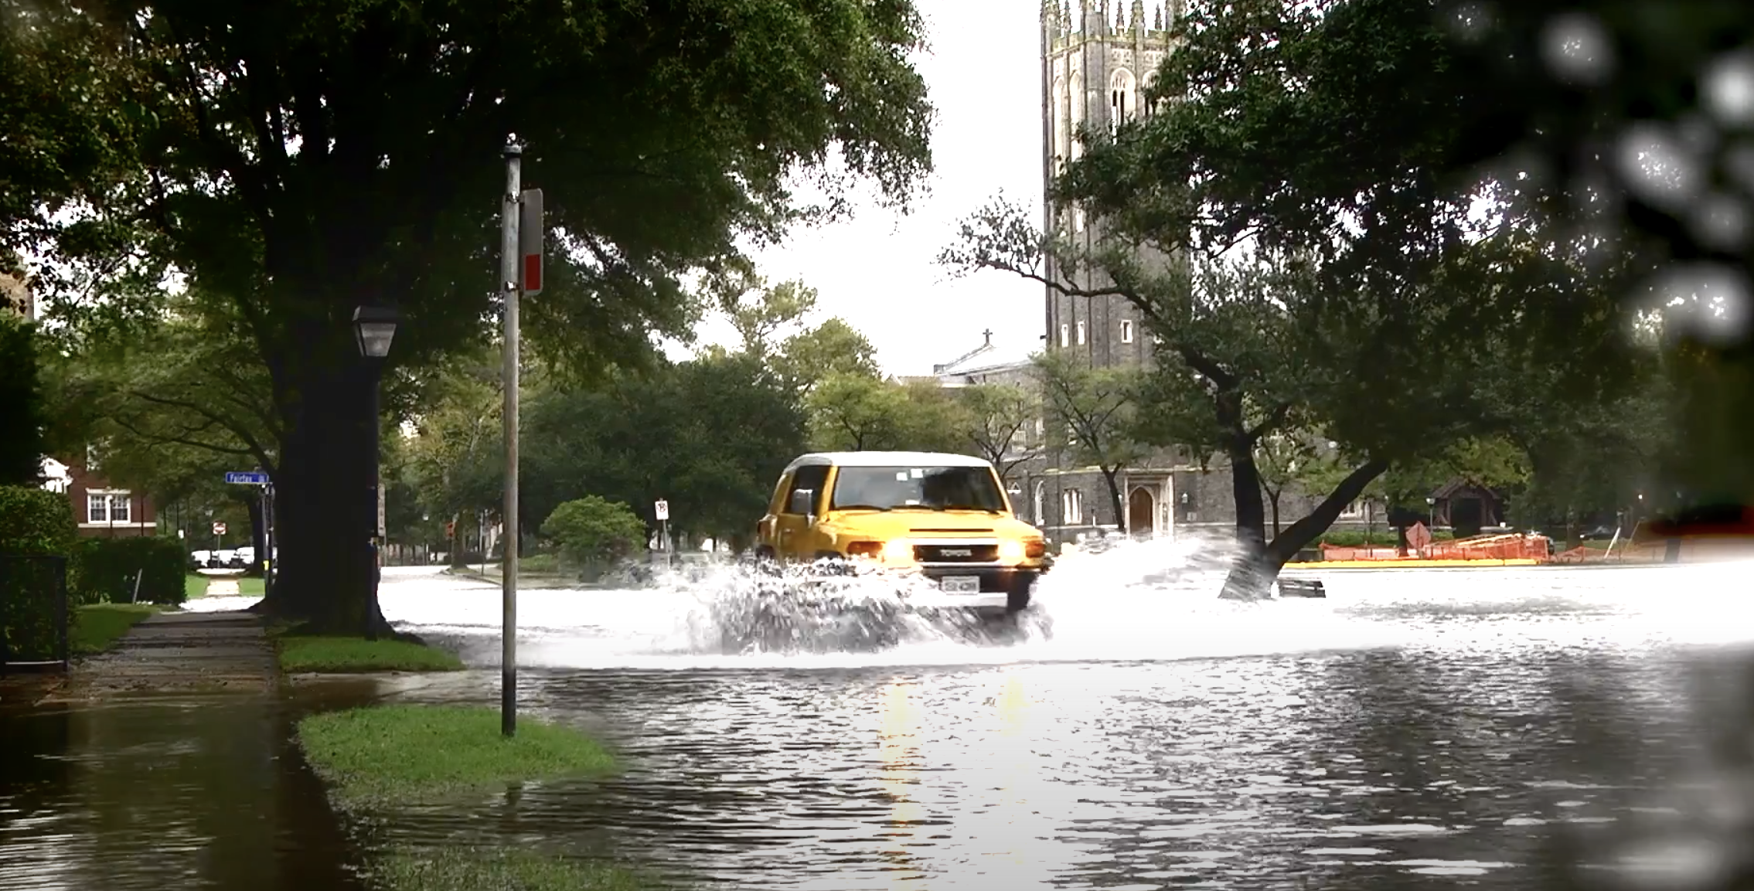
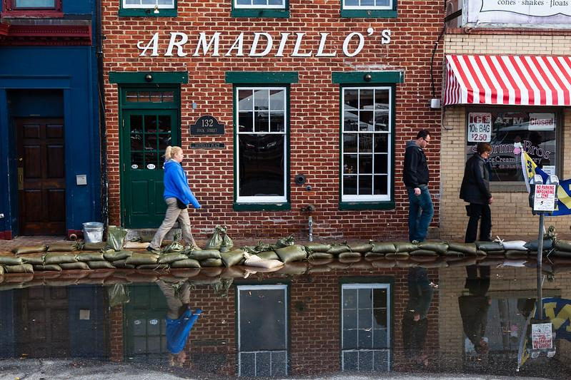
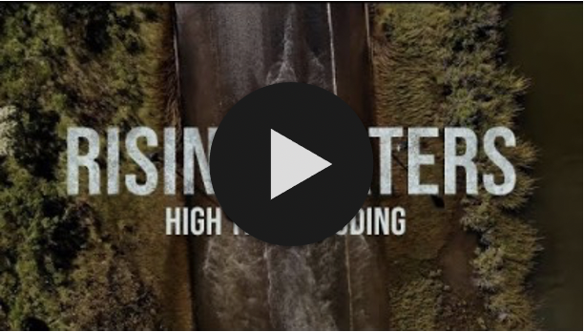
Planning for Higher Waters
Sea level rise is likely to worsen existing flooding issues because of increased stress on stormwater systems and tidal flooding. Sunny day flooding (or high-tide or nuisance flooding) is accelerating on the East Coast, with VA and MD being home to 6 of the 19 locations nationwide seeing record-setting flood days in 2019. See how your community would fare under various sea level rise scenarios with an interactive map by NOAA.
Case study: Norfolk, VA
Norfolk, VA adopted a zoning ordinance in 2018 that directs new and more intense development to be built on higher ground to mitigate flooding and sea level rise. It establishes a Coastal Resilience Overlay zone where development will have new flood resilience requirements, and an Upland Resilience Overlay designed to encourage new development in areas of the city with lower risk of flooding.
Case study: Annapolis, MD
Learn about sunny day flooding in this short video from NASA:
In 2017, sunny day flooding was estimated to cost Annapolis businesses $86,000-172,000 in lost revenue due to nearly 3,000 fewer visitors to historic downtown. Even after the waters receded, the decrease in patrons remained.
Protecting Your Infrastructure
Planning for the Future
Notes:
References:
https://www.epa.gov/arc-x/climate-adaptation-and-stormwater-runoff
https://tidesandcurrents.noaa.gov/publications/Techrpt_092_2019_State_of_US_High_Tide_Flooding_with_a_2020_Outlook_30June2020.pdf
Photo from https://www.norfolk.gov/Blog.aspx?IID=786#item and W. Parson/Chesapeake Bay Program

Slide 26
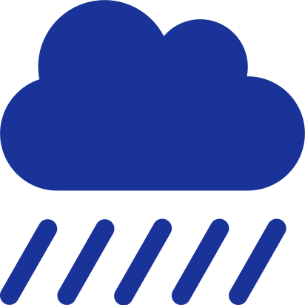
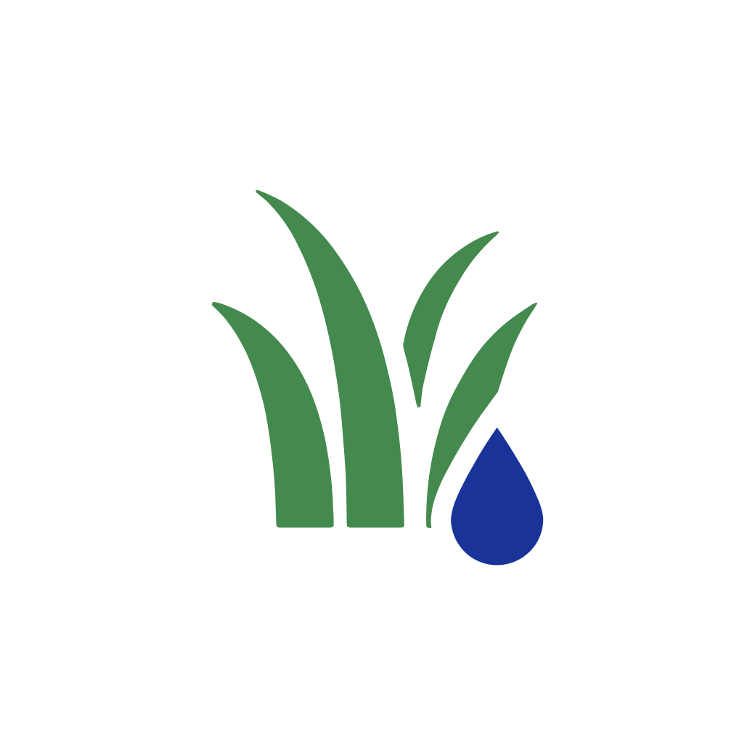
What You Can Do
Meet with your MS4 coordinator or stormwater engineer to discuss strategies, like implementing green infrastructure, to reduce strain on your stormwater management systems.
Protect and restore valuable wetlands and other natural landscapes that act as nature’s flood insurance, filter stormwater, and protect your community’s infrastructure.
Build flexibility and adaptability into your community’s plans to allow for changes in design and construction, as well as maintenance of infrastructure, as conditions change.

Slide 27
To Learn More
Naturally Resilient Communities
Includes case studies and funding information for nature-based solutions to flooding
University of Maryland’s Municipal Online Stormwater Training Center (MOST)
Online courses ranging from financing to construction and a library of resources, including case studies
First Street Foundation
Information and research on flooding, plus search for flood risk in your community with Flood Factor
Wetlands Watch
Resources on sea level rise, floodplain management, conservation landscaping, and citizen action
EPA’s Green Infrastructure Portal and Green Infrastructure Opportunities that Arise During Municipal Operations
Build, learn, and partnership resources, including a summary of the costs, benefits, planning steps, and options for green infrastructure projects
Chesapeake Bay Program Stormwater Runoff
Primer on stormwater runoff and the Chesapeake Bay, including short 1:30 minute video
Chesapeake Stormwater Network’s Why Watersheds Matter
Listen to a webcast on watershed importance through Adobe Connect
Chesapeake Bay Program Toxic Contaminants Workgroup
Latest information and products on toxic contaminant issues, including multi-lingual fish consumption communication products
Chesapeake Bay Program’s Planting Your Own Rain Garden
Learn and share this one-pager about rain gardens – what they are, what they do, and how to get started

Slide 28
Glossary
Stormwater Runoff
Precipitation that does not evaporate or soak into the ground but instead runs across the land and into the nearest waterway
Impervious Surfaces
Paved or hardened surfaces that do not allow water to pass through (e.g., roads, rooftops, sidewalks, pools, patios, and parking lots)
MS4: Municipal Separate Storm Sewer System
A collection of structures designed to gather stormwater and discharge it into local streams and rivers
Microplastics
The tiny (<5 mm) fragments, fibers, and microbeads that come from larger plastic litter breaking apart and persist in the environment for an extremely long time
Toxic Contaminants
Pesticides, pharmaceuticals, metals and more that can harm human and wildlife health. An example is mercury, which is toxic to nervous, digestive, and immune systems as well as lungs, kidneys, skin & eyes
Algae
Simple aquatic plants that can be single-celled or grow in clumps or slimy mats
Green Infrastructure
Nature-based solutions that use soil and vegetation to help slow the flow of runoff and manage rainwater where it falls
Sunny Day Flooding
Flooding associated with high tide, rather than rainfall, that is temporary with localized impacts

